Slide 1
OBJECT ORIENTED PROGRAMMING (PBCST304)
Prepared by Ms.Renetha J.B.

Slide 2
Module 1
OOP Concepts :- Data abstraction, encapsulation, inheritance, polymorphism,
Procedural and object oriented programming paradigm; Microservices.
Introduction to Java:: Structure of a simple java program;
Java programming Environment and Runtime Environment (Command Line & IDE); Java compiler; Java Virtual Machine;
Primitive Data types and Wrapper Types; Casting and Autoboxing;
Arrays; Strings; Vector class;
Operators - Arithmetic, Bitwise, Relational, Boolean Logical, Assignment, Conditional (Ternary); Operator Precedence;
Control Statements - Selection Statements, Iteration Statements and JumpStatements;
Functions;
Command Line Arguments; Variable Length Arguments;
Classes; Abstract Classes; Interfaces. [Use proper naming conventions]
Object Oriented Programming in Java :- Declaring Objects; Object Reference; Introduction to Methods; Constructors; Access Modifiers; this keyword
Prepared by Renetha J.B. .

Slide 3
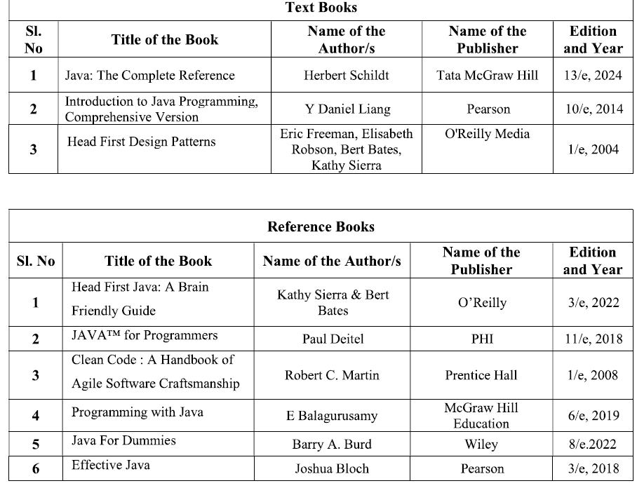
Prepared by Renetha J.B. .

Slide 4
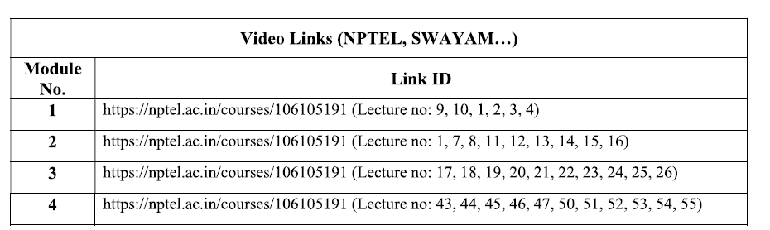
Prepared by Renetha J.B. .

Slide 5
PBCST304
Object oriented Programming
MODULE 1
Topic:OOP concepts
Prepared by Renetha J.B. .

Slide 6
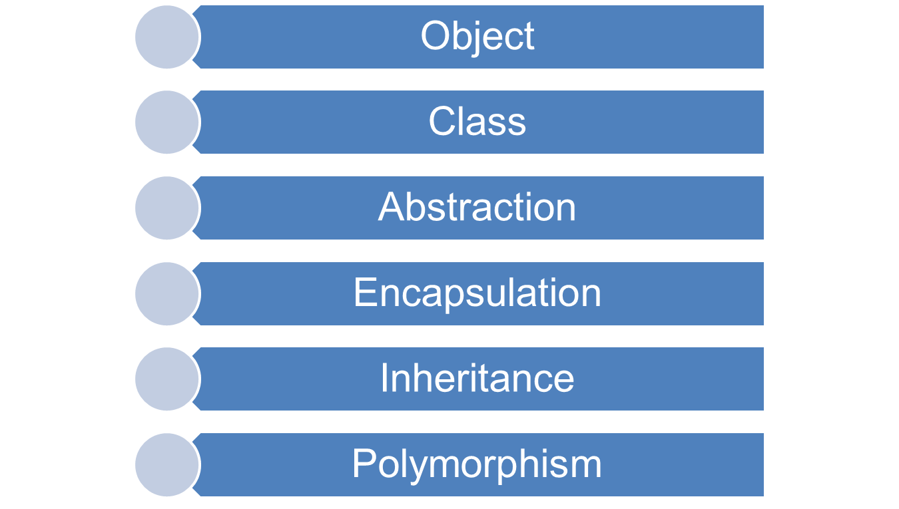
BASIC OBJECT-ORIENTED PROGRAMMING CONCEPTS
Prepared by Renetha J.B. .

Slide 7
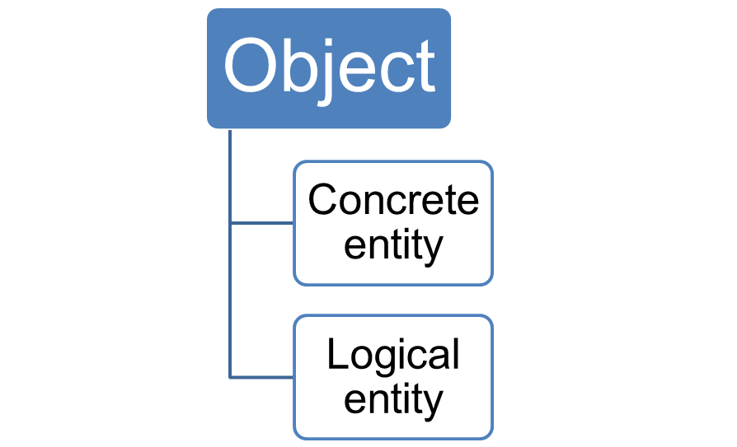
OBJECTS
Objects are real-world entities(things) that have their own properties and behavior.
Prepared by Renetha J.B.

Slide 8
Object
Object can be
  concrete entity-
    a tangible real-world entity. It can be touched. Physical existence is there.
    E.g. student, library member, a book, an issue register, etc.
  logical entity-
    conceptual real-world entity. No physical existence. It is just a concept.
    E.g Loan, Account, Job etc
Prepared by Renetha J.B.

Slide 9
Object- Characteristics
Object consists of
  Data (attributes or properties)
    is private to the object
  a set of functions (operations or methods )
    operate on those data.
Objects are real-world entities that have their own properties and behavior.
Prepared by Renetha J.B. .

Slide 10
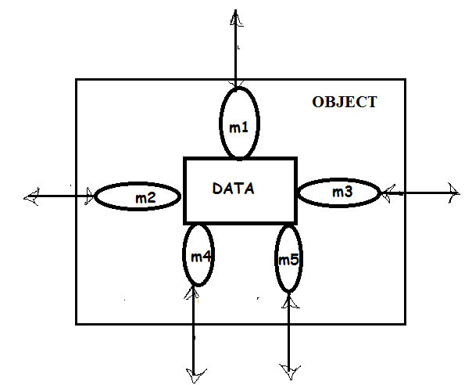
Object
Here m1 , m2 etc. are methods associated with object.
Data of an object cannot be directly accessed from outside.
Data can be accessed through methods associated with object.
Each object hides its internal data from other objects.
An object can access the private data of another object by invoking(calling) the methods supported by that object.
Prepared by Renetha J.B. .

Slide 11
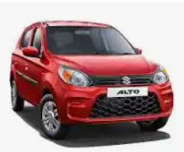
This car is an object
Data(Attributes):
  Colour - "Red”
  Model – “Alto”
  Manufacturer - “Maruthy Suzuki”
Methods(functions):
  accelerate(): Increases speed
  brake(): Decreases speed
  honk(): Outputs a sound
Prepared by Renetha J.B. .

Slide 12
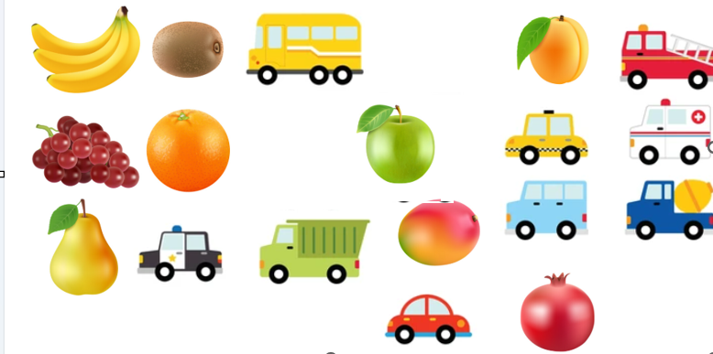
Objects
Prepared by Renetha J.B. .

Slide 13


Class
Similar Objects can be grouped into a Class.
Class Fruit
Class Vehicle
Similar objects
Similar objects
Prepared by Renetha J.B. .

Slide 14
Class
Class is a group of similar objects.
A class is a blueprint or prototype from which objects are created.
A class is a generalized description of an object.
An object is an instance of a class.
Prepared by Renetha J.B. .

Slide 15
Class(contd.)
All the objects in a class, possess similar attributes (data or properties) and methods (behaviour or functions or operations).
E.g Set of all students(objects) form Student class
Each student object possesses their own
  attributes(data)- Roll number, name etc.
  behaviour(methods)- study(), read(), write() etc.
  Eg. Arun is a student. His roll number 1.
Prepared by Renetha J.B. .

Slide 16
Example
Set of all library members(objects) constitute the class LibraryMember
  attributes(data)
    membership_number, role, name, email, borrowedbooks, max-borrow_linit etc.
  behaviour(method)
    borrow_book(), return-book(), pay_fine() etc.
Prepared by Renetha J.B. .

Slide 17
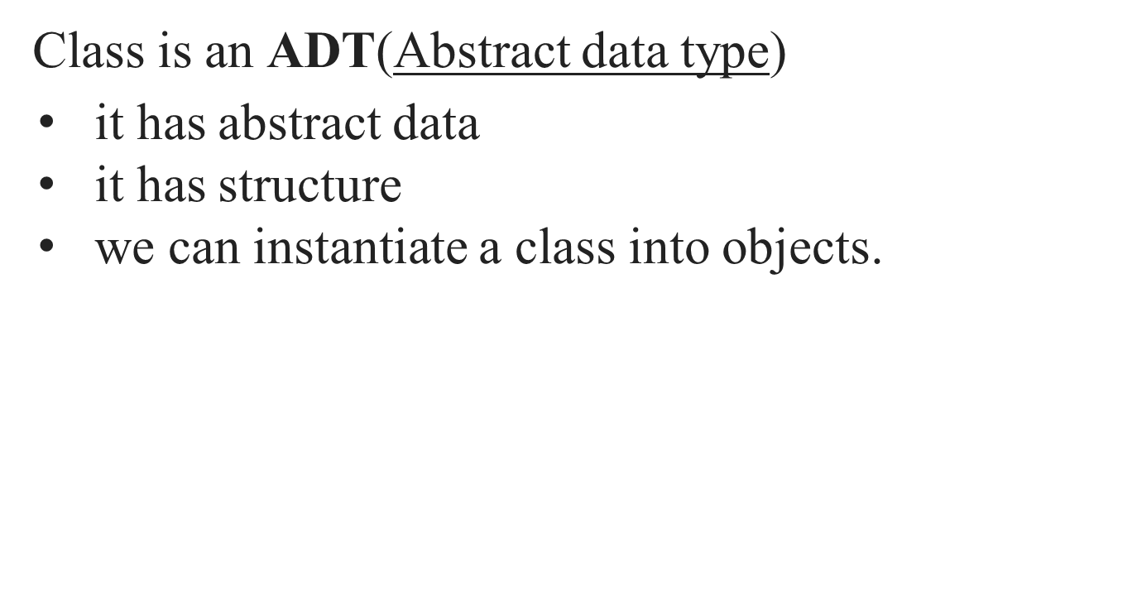
Class-ADT
Prepared by Renetha J.B. .

Slide 18
Class and Object
Object has a physical existence
Class is just a logical definition.
Consider Student class. (it is logical)
  Sam is a student.(physical existence is there) Sam is instance/object of the class Student.
Prepared by Renetha J.B. .

Slide 19
Abstraction
Abstraction means displaying only essential information and hiding the inner details.
Abstraction
  consider only those aspects of the problem that are relevant to a given purpose
  suppresses all aspects of the problem that are not relevant.
Prepared by Renetha J.B. .

Slide 20
Abstraction(contd.)
Abstraction is supported in two different ways in an object-oriented designs (OODs).
  Feature abstraction- A class hierarchy can be viewed as different levels (hierarchy) of abstraction,
    Class hierarchy- class can have subclasses.(Inheritance).
  Data abstraction - each object hides the way in which it stores its internal information from other objects .
Prepared by Renetha J.B. .

Slide 21
Data abstraction-Real world example
Consider a man driving a car.
The man only knows that pressing the accelerators will increase the speed of the car or applying brakes will stop the car
But he may not know about how on pressing accelerator the speed is actually increasing.
He may not know about the inner mechanism of the car or the implementation of accelerator, brakes etc in the car.
This is what abstraction is.
Prepared by Renetha J.B. .

Slide 22
Data abstraction -Advantage
Important advantages of data abstraction is
  It reduces coupling among various objects
    Objects do not directly access any data belonging to each other.
  It leads to a reduction of the overall complexity of a design.
  It helps in easy maintenance and code reuse.
Prepared by Renetha J.B. .

Slide 23
Encapsulation
The wrapping up of data(variables) and functions (methods) into a single unit (called class) is known as encapsulation.
Prepared by Renetha J.B. .

Slide 24
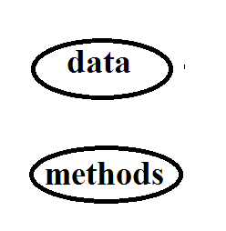
Prepared by Renetha J.B. .

Slide 25
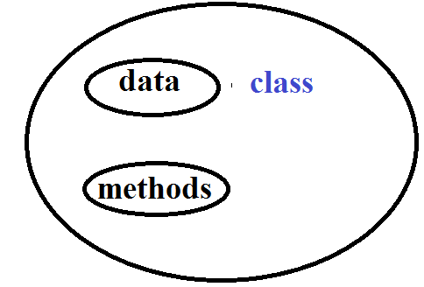
Encapsulation
Prepared by Renetha J.B. .

Slide 26
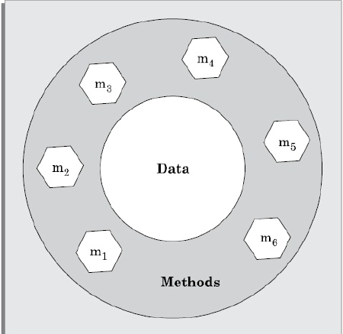
Encapsulation
Prepared by Renetha J.B. .

Slide 27
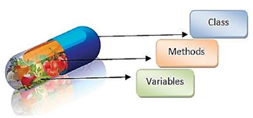
Encapsulation
Prepared by Renetha J.B. .

Slide 28
Encapsulation - Advantage
Encapsulation offers the three important advantages:
Protection from unauthorized data access:
  Protect data from accidental corruption and concurrent access(simultaneous access) problems.
Data hiding-Helps to hide the internal structure data of an object.
  provides abstraction, easier maintenance and bug correction.
Weak coupling- Since objects do not directly change each others internal data, they are weakly coupled. This enhances understandability of the design.
Prepared by Renetha J.B. .

Slide 29
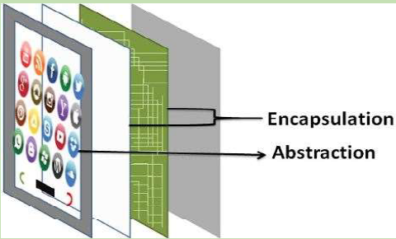
Prepared by Renetha J.B. .

Slide 30
Inheritance
The capability of a class to derive properties and characteristics from another class is called Inheritance.
Through inheritance, objects of one class acquire the properties of objects of another classes.
Prepared by Renetha J.B. .

Slide 31
Inheritance(contd.)
Derived Class: The class that inherits properties from another class is called Subclass or Derived class or child class.
Super Class : The class whose properties are inherited by subclass is called Base Class or Superclass or parent class.
E.g. Doctor is a superclass. Surgeon and Neurologist are its subclasses
Subclasses inherit properties from Super class.
Prepared by Renetha J.B. .

Slide 32
Inheritance
A base class can be specialized into derived classes.
  Eg: Employee- Teacher, Manager, Banker
A base class is a generalization of its derived classes.
  Base class contains properties (i.e., data and methods) that are common to all its derived classes.
Derived class inherit the properties of base class. Derived class can have its own special properties also.
  Eg Teacher class inherits properties from Employee class. Teacher class has its own special properties.
Prepared by Renetha J.B. .

Slide 33
Base class- Derived class
Each derived class can be considered as a specialization of its base class
  because it modifies or extends the basic properties of the base class in certain ways.
Therefore, the inheritance relationship can be viewed as a generalization-specialization relationship.
Prepared by Renetha J.B. .

Slide 34
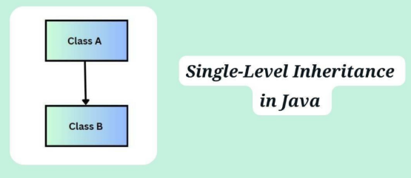
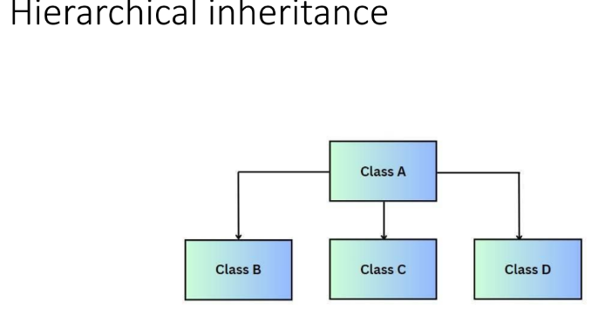
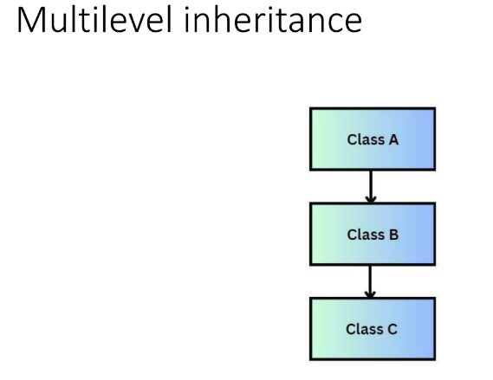
Types of inheritances
Single inheritance
Multi level inheritance
Hierarchical inheritance
Prepared by Renetha J.B. .

Slide 35
Inheritance - Example
Consider the classes Person, Employee, Student.
  Employee is a Person
  Student is a person
Prepared by Renetha J.B. .

Slide 36
Inheritance - Example
Consider the classes Person, Employee, Student.
  Employee is a person
  Student is a person
  Employee and Student inherit the properties of Person class
  Super(base) class - Person
  Derived(sub) classes - Employee ,Student
Prepared by Renetha J.B. .

Slide 37
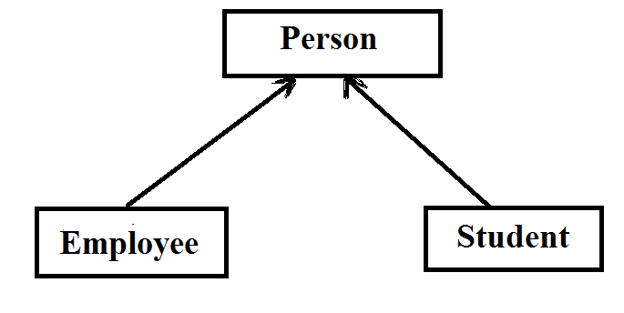
Prepared by Renetha J.B. .

Slide 38
Inheritance example
Person class
  data - name, aadhaar number, address , data-of-birth
  Methods-enter_details(), modify_details().
Employee is a subclass of class Person.
  It contains data and methods specific to employee such as
    Data - empid, designation,
    Methods- calculate_experience().
Employee
  Data- name, aadhaar number, address,
  data-of-birth, empid, designation
  Methods - enter_details(),modify_details(),
  calculate_experience()

Slide 39
Inheritance - Example
Faculty, students, and library staff are library members.
Base class(superclass)- ?
Derived class(subclass) -?
Prepared by Renetha J.B. .

Slide 40
Inheritance - Example
Faculty, students, and library staff are library members.
Base class(superclass)- Library member
Derived class(subclass) -Faculty ,students , library staff
Prepared by Renetha J.B. .

Slide 41
Inheritance - Example
Faculty, students, and library staff are library members.
Students fall in three categories PG, UG and research-scholars.
Prepared by Renetha J.B. .

Slide 42
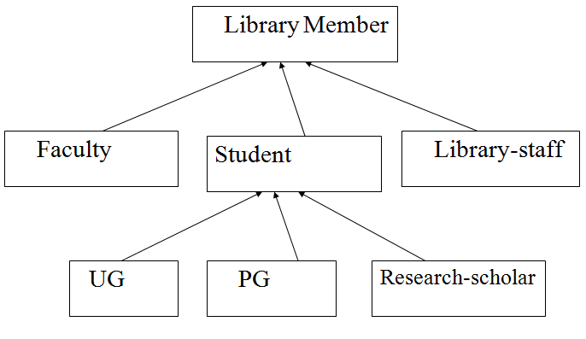
Class hierarchy
Prepared by Renetha J.B. .

Slide 43
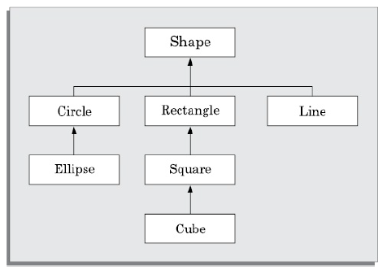
Class hierarchy of geometric objects
Prepared by Renetha J.B. .

Slide 44
Inheritance
  A is a kind of B
  A is a specialization of B
  A behaves like B
Prepared by Renetha J.B. .

Slide 45
Polymorphism
Polymorphism literally means poly (many) morphism (forms).
Real world example
  Diamond, graphite, and coal are called polymorphic forms of carbon
Prepared by Renetha J.B. .

Slide 46
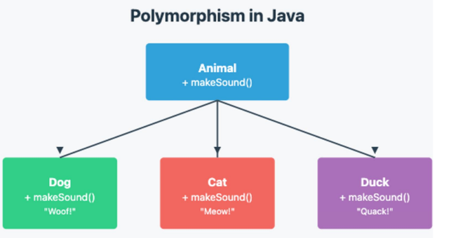
Prepared by Renetha J.B. .

Slide 47
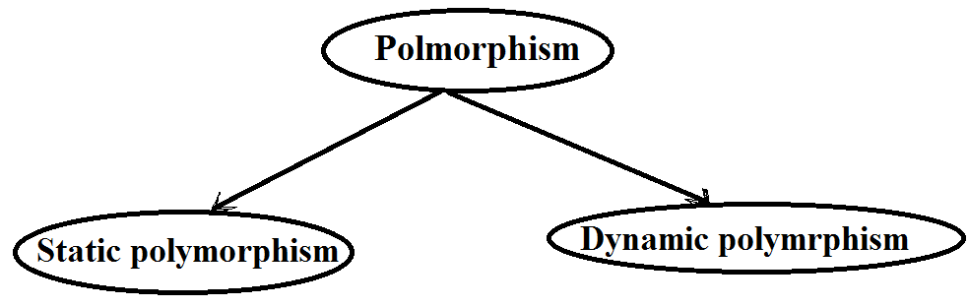
Prepared by Renetha J.B. .

Slide 48
Static(compile time)polymorphism
Static polymorphism is also called static binding.
In static polymorphism, a program has different methods(functions) with same name but different parameter types or number of parameters .
  Here, when method is invoked(called), which method is to be bounded to the method-call is determined at compile-time (statically).
Prepared by Renetha J.B. .

Slide 49
Static(compile time)polymorphism
  Example:
  Suppose there are functions add(int a, int b) add(int a, int b, int c) in a program.
    When add method is invoked(called), which add method is to be called( bound to the method-call) is determined at compile-time (statically).
      add(2,3) will call the function add(int a, int b)
      add(5,4,3) will call the function add(int a, int b,int c)
      This decision will be taken at compile time
Prepared by Renetha J.B. .

Slide 50
Method overloading- static binding
Method overloading is a static polymorphism.
Here a program (class) can have different functions with same name (but has different number of parameters or different parameter types).
Prepared by Renetha J.B. .

Slide 51
Method overloading-Example
E.g. Consider class named Circle
  Assume that this class has three definitions for the create operation(method)—
    void create()
      draws a circle with radius given inside create() function
    void create(int radius)
      draws a circle with radius passed to create() function
    void create(float x, float y, int radius);
      draws a circle with radius at specific position in x, y coordinate passed to create() function
Prepared by Renetha J.B. .

Slide 52
Example-static polymorphism(contd.)
When create function is called without parameter then void create() method is invoked.
When create function is called with one integer parameter then void create(int radius) method is invoked.
When create function is called with three integer parameters then void create(int x, int y, int radius) method is invoked.
Prepared by Renetha J.B. .

Slide 53
Dynamic polymorphism
Dynamic polymorphism is also called dynamic binding.
In dynamic binding, when a method is called , the exact method to be invoked (bound) is known at the run time (dynamically) and cannot be determined at compile time.
Prepared by Renetha J.B. .

Slide 54
Dynamic polymorphism(contd.)
Dynamic binding is based on two important concepts:
  Assignment of an object to another compatible object.
  Method overriding
Prepared by Renetha J.B. .

Slide 55
Dynamic polymorphism(contd.)
Assignment to compatible of objects
  In object-orientation, objects of the derived classes are compatible with the objects of the base class.
  That is, an object of the derived class can be assigned to an object of the base class, but not vice versa.
  baseclassobject=derivedclassobject
Method overriding
  If subclass contain same method name as superclass then subclass method overrides superclass method
Prepared by Renetha J.B. .

Slide 56
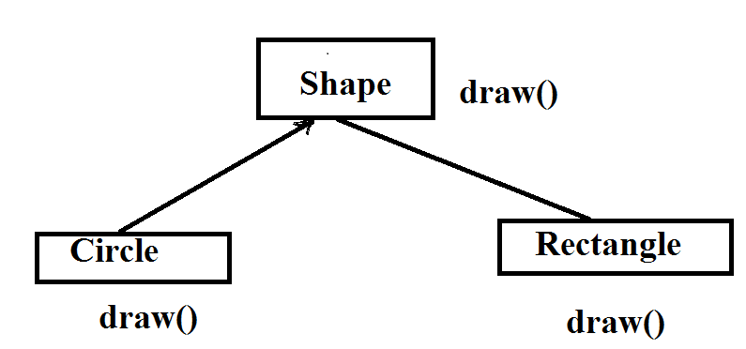
Method overriding Method overriding
Shapeobject=circleobject;
Shapeobject.draw();
This will call draw() in
Circle class
Shapeobject=rectangleobject;
Shapeobject.draw();
This will call draw() in
Rectangle class
Which draw() function to call is decided only at RUNTIME
Prepared by Renetha J.B. .

Slide 57
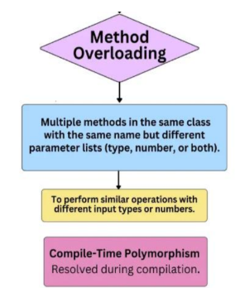
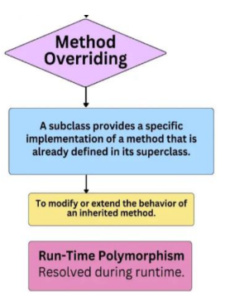
Prepared by Renetha J.B. .

Slide 58
Advantage of dynamic binding
The principal advantage of dynamic binding :-
  it leads to elegant programming and facilitates code reuse and maintenance.
  code is much more concise, understandable, and intellectually appealing.
Prepared by Renetha J.B. .

Slide 59
Advantages of OOP
Code and design reuse
Increased productivity
Ease of testing and maintenance
Better code and design understandability enabling development of large programs
Prepared by Renetha J.B. .

Slide 60
Disadvantages of OOD
The principles of abstraction, data hiding, inheritance, etc. do incur runtime overhead.
An important consequence of object-orientation is that the data gets scattered across various objects in an object-oriented implementation.
Prepared by Renetha J.B. .

Slide 61
Object-oriented Programming Language(OOPL)
The first object-oriented programming language was Smalltalk.
Other OOPL are C++, Java etc.
Prepared by Renetha J.B. .

Slide 62
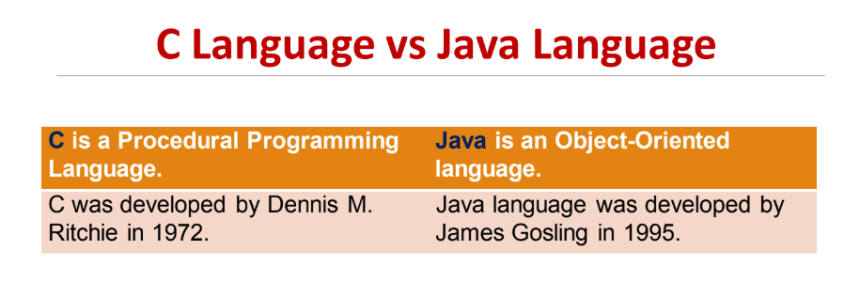

Slide 63
